Slide 1
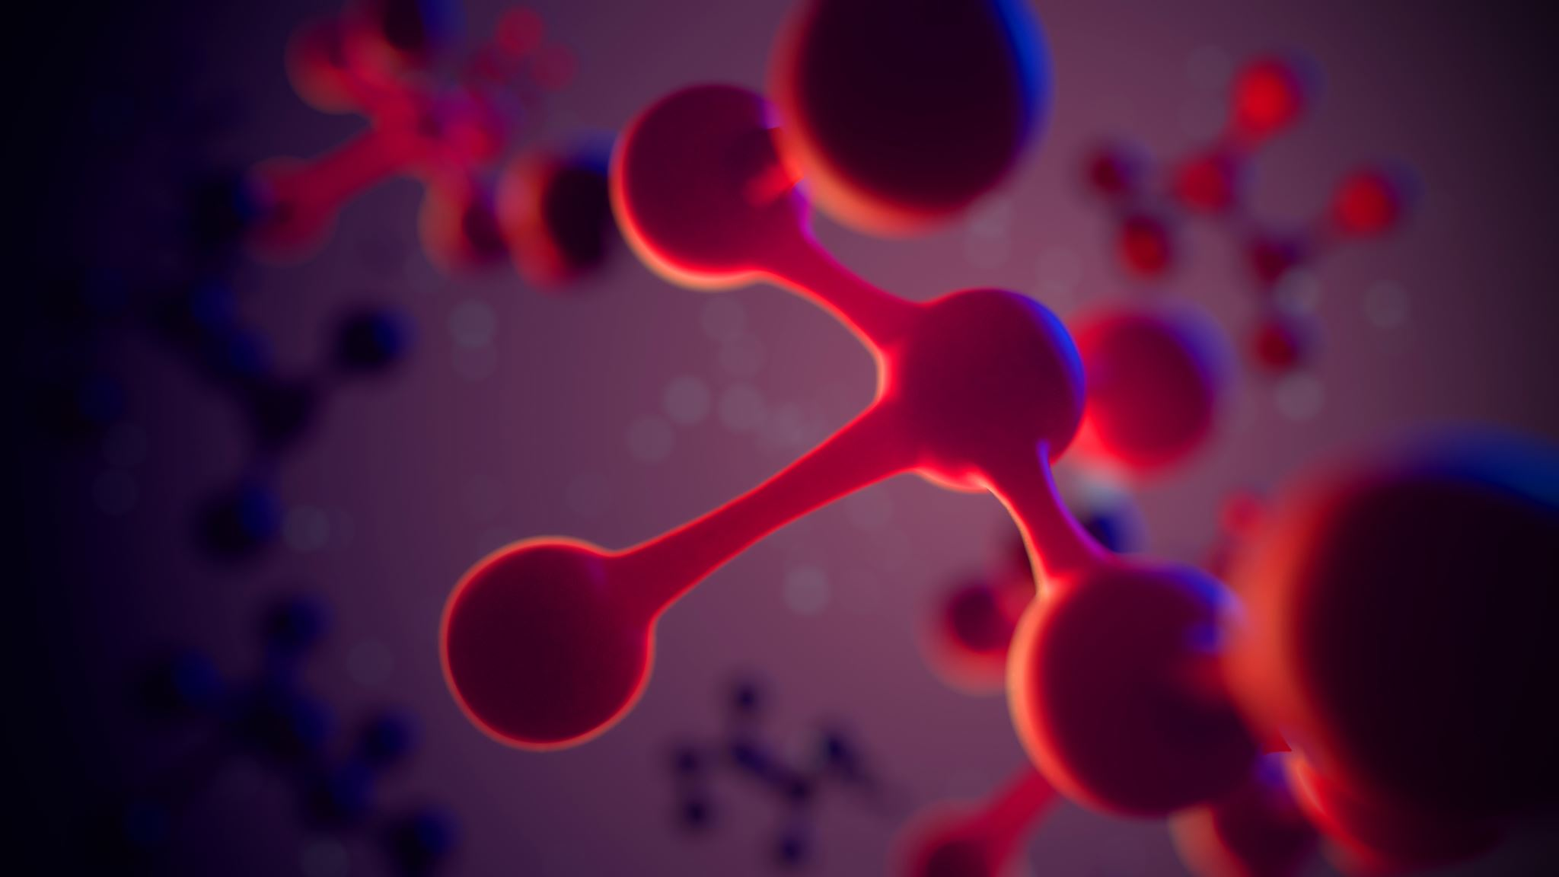
Hybrid Quantum Neural Networks for Image Classification
CSCI 373
Explorations Project
Andrew Nerud

Slide 2
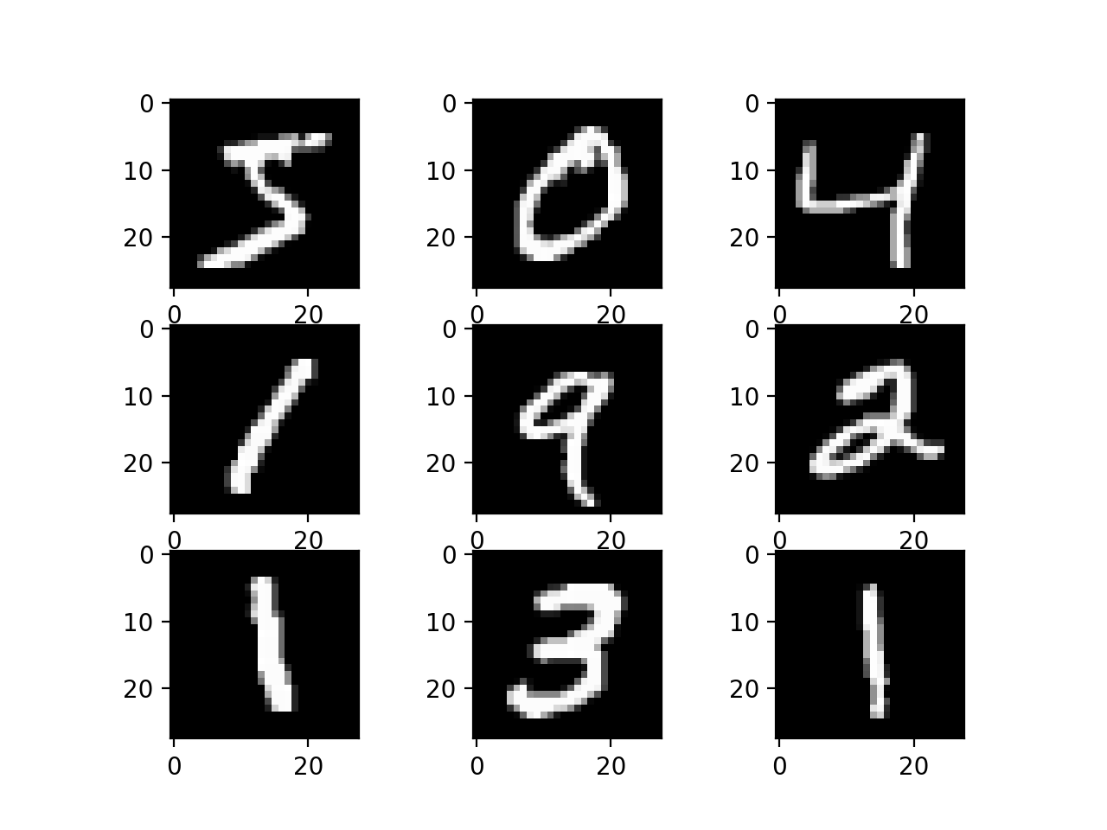
Hypothesis and Experiment Setup
Hypothesis:
comparable performance
fewer parameters
Dataset:
MNIST (Handwritten digits 0-9)
Tools
TensorFlow (Model Training)
PennyLane (Quantum)
NumPy (Data)
Matplotlib (Visualization)

Slide 3



Classical CNN Model
Hybrid Quantum-CNN Model

Slide 4
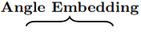
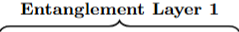
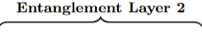
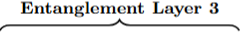
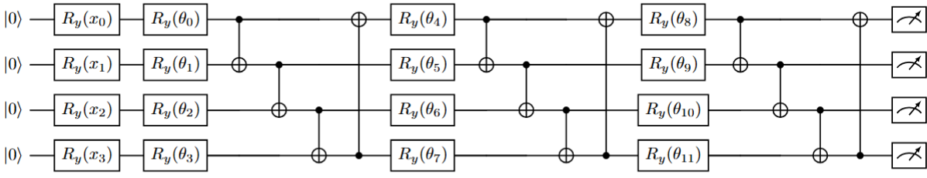


Quantum Circuit Design
4 Qubits
Angle Encoding
3 Entanglement Layers
12 Trainable Parameters (θ₀ – θ₁₁)
Measurement Gates (z-axis)

Slide 5

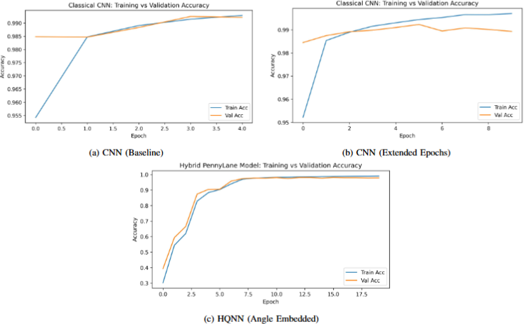
Results . HQNN vs. CNN
~1.5% less accuracy with the HQNN
Training time
2 hours vs. 3 minutes
~(6 minutes for same number of epochs)
However:
88.04% fewer parameters
63.11% fewer FLOPs

Slide 6
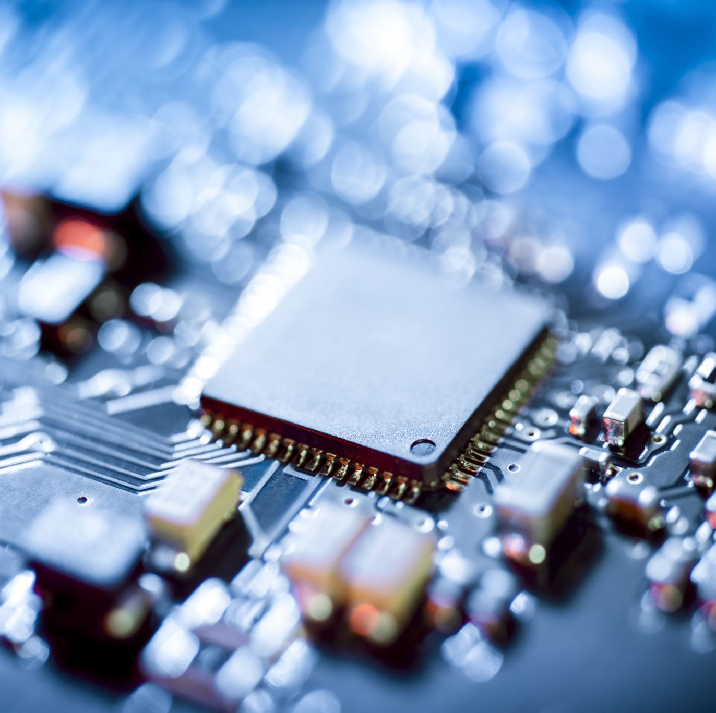
Limitations and Insights
Compact models with fewer parameters
Slower training due to simulation limits
Dependent on future quantum hardware
Shows promise, but dependent on future innovations

Slide 7
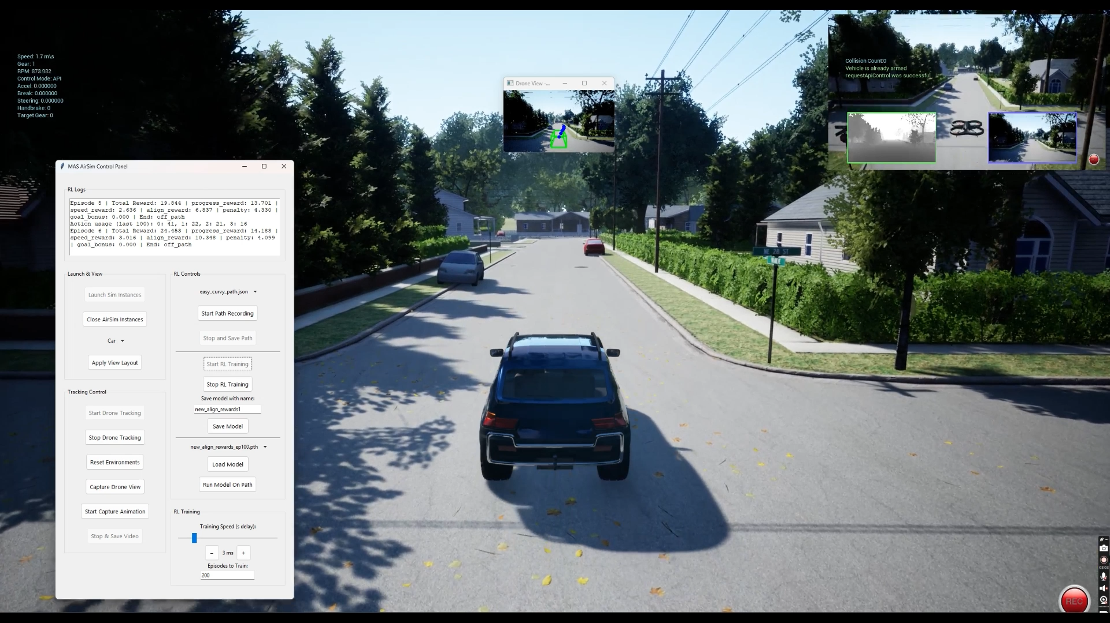
Upcoming Research

Slide 8

Thank you!

